Slide 1
Unit-3
Cont…

Slide 2
Multivalued Dependency
Multivalued dependency occurs when two attributes in a table are independent of each other but, both depend on a third attribute.
A multivalued dependency consists of at least two attributes that are dependent on a third attribute that's why it always requires at least three attributes.

Slide 3
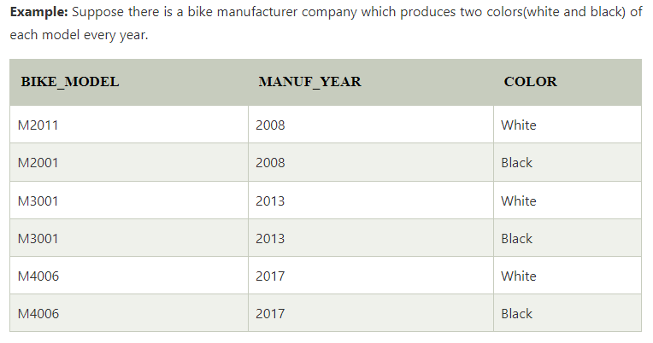
Here columns COLOR and MANUF_YEAR are dependent on BIKE_MODEL and independent of each other.
In this case, these two columns can be called as multivalued dependent on BIKE_MODEL. The representation of these dependencies is shown below:
BIKE_MODEL → → MANUF_YEAR
BIKE_MODEL → → COLOR

Slide 4
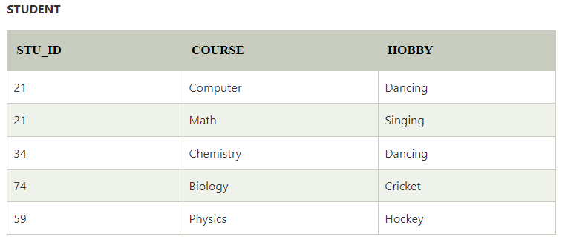
4NF
Any relation is said to be in the fourth normal form when it satisfies the following conditions:
It must be in Boyce Codd Normal Form (BCNF).
It should have no multi-valued dependency.

Slide 5
Join Dependency
Join decomposition is a further generalization of Multivalued dependencies. If the join of R1 and R2 over C is equal to relation R then we can say that a join dependency (JD) exists, where R1 and R2 are the decomposition R1(A, B, C) and R2(C, D) of a given relations R (A, B, C, D).
Alternatively, R1 and R2 are a lossless decomposition of R. A JD ⋈ {R1, R2, …, Rn} is said to hold over a relation R if R1, R2, ….., Rn is a lossless-join decomposition.
The *(A, B, C, D), (C, D) will be a JD of R if the join of join’s attribute is equal to the relation R.
Here, *(R1, R2, R3) is used to indicate that relation R1, R2, R3 and so on are a JD of R.

Slide 6
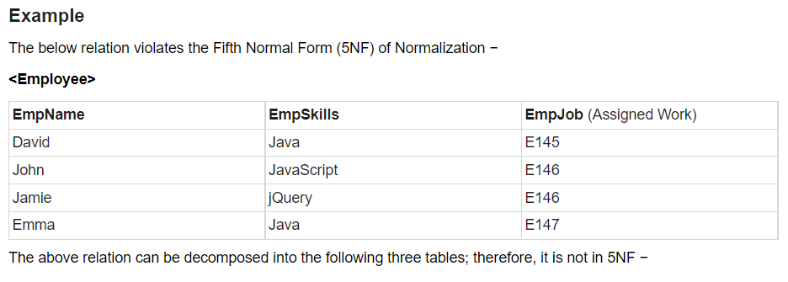
5NF
A relation is in Fifth Normal Form (5NF), if it is in 4NF, and won’t have join dependency.
You can also consider that a relation is in 5NF, if the candidate key implies every join dependency in it.

Slide 7
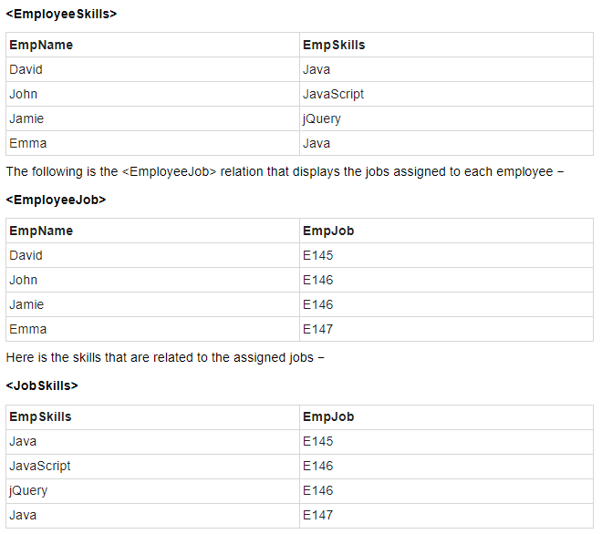

Slide 8
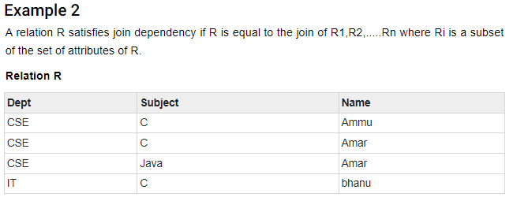
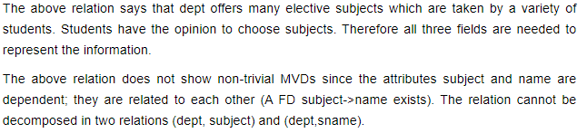

Slide 9
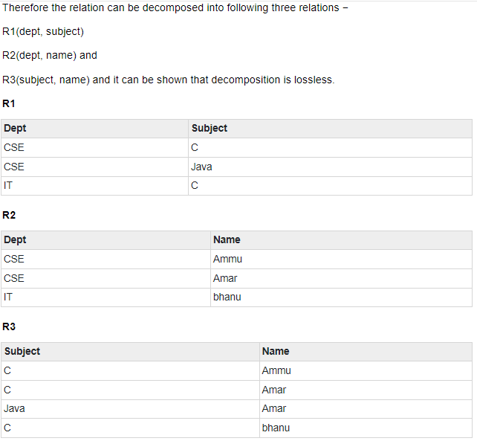

Slide 10
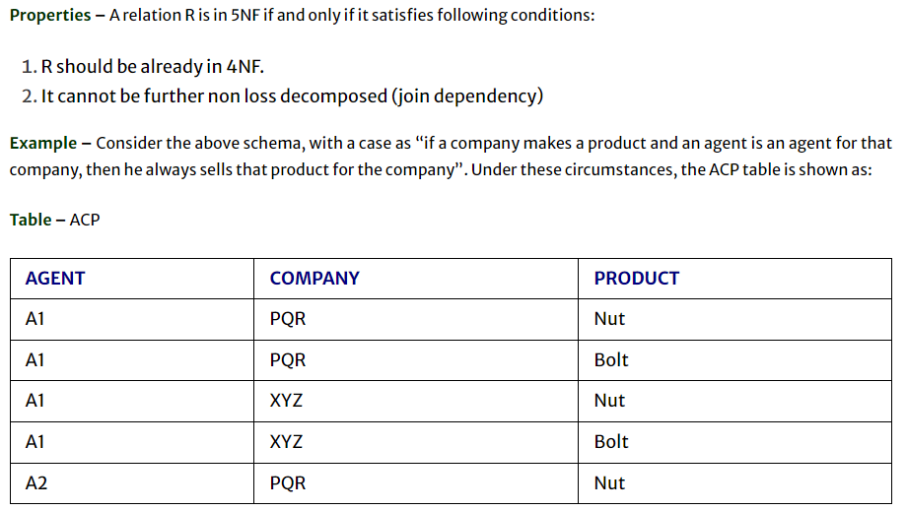
EXAMPLE - 3

Slide 11
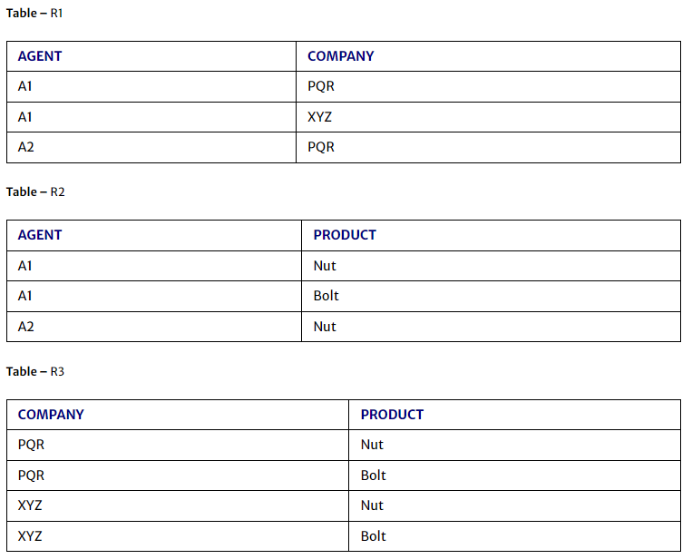
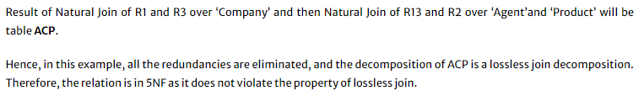

Slide 12
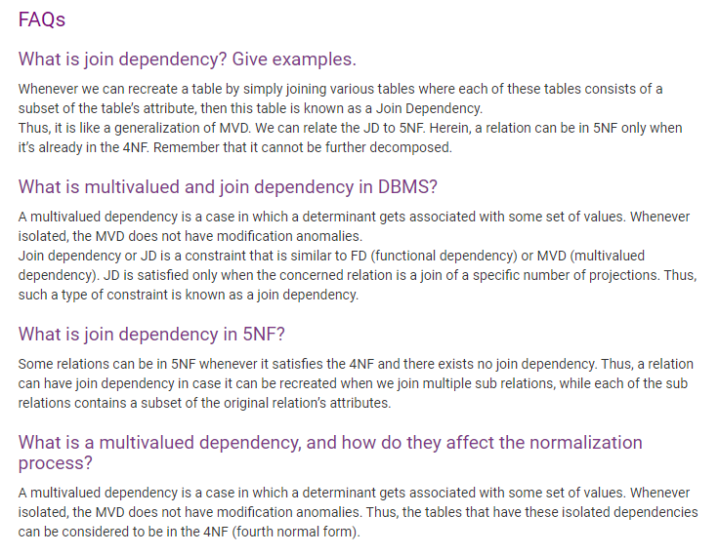

Slide 13
PL / SQL
It is a development tool
Supports SQL manipulation and also provide facilities of condition checking, branching and looping
Entire PL/SQL block is sent all in one to the Oracle engine for execution
It permits error handling
Variables can be declared and values can be stored inside that variable using user input as well as from SQL statement
Applications written in PLSQL are portable to any computer h/w and s/w
PL/SQL engine resides inside the oracle engine

Slide 14
PL/SQL
Generic PL/SQL block:
Declare Section
Here, memory variable an other Oracle objects can be declared, initialized if required. It’s an optional block
Begin Section
It consists of a set of SQL and PL/SQL statements, which describe process that have to be applied to table data.
Exception Section
This section deals with handling of errors that arise during execution of the data manipulation statements, by PLSQL code block
End Section
It marks the end of the PLSQL block.

Slide 15
PLSQL Character Set
Every database character set includes these basic characters:
Latin letters: A through Z and a through z
Decimal digits: 0 through 9
Punctuation characters like: () + - * / < > = ! , : . ‘ @ % “ # $ ^ & _ \ { } ? ||
Whitespace characters: space, tab, new line, and carriage return

Slide 16
Control Structure
Condition Control ---- IF – ELSEIF – ELSE – END IF
Iterative Control ----- While Loop, FOR Loop
Sequential Control ----GOTO Statement

Slide 17
Syntax
IF <condition> then
<Action>
ELSIF <Condition> then
<Action>
ELSE
<Action>
END IF;

Slide 18
Iterative Control - Syntax
LOOP
<Sequence of Statements>
<increment or decrement of variable>
EXIT WHEN <Condition>
END LOOP;
WHILE <Condition>
LOOP
<Sequence of Statements>
<increment or decrement of variable>
END LOOP;

Slide 19
Syntax
FOR variable in [Reverse] start .. End
LOOP
<Action>
END Loop;
The variable in the For Loop need not be declared. Also the increment value cannot be specified.
The FOR Loop Variable is always incremented by 1

